Slide 1
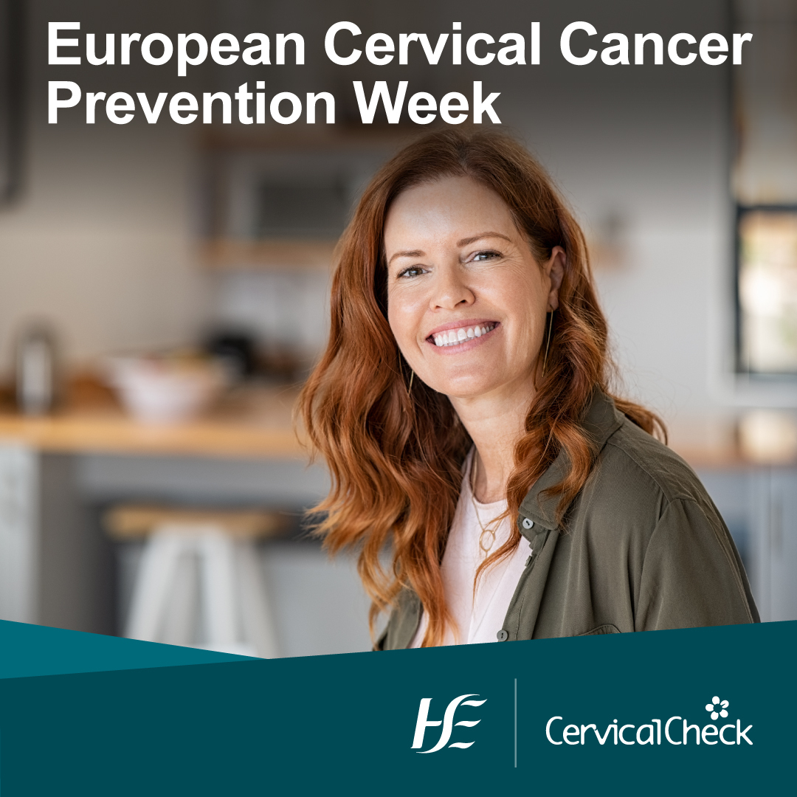


Partner Pack
18-24 January 2021
www.hse/cervicalcheck

Slide 2
European Cervical Cancer Prevention Week
European Cervical Cancer Prevention Week runs from 18-24 January 2021.
Our messages during this week will continue to highlight that HPV cervical screening is the best way to see if someone is at risk of developing cervical cancer in the future.
We have developed a new video with Dr Nóirín Russell, Clinical Director, CervicalCheck, discussing HPV cervical screening.
We will communicate and engage with our 25-65 year old audience through multiple communications channels: social media, video on demand, digital display and online articles, which you can view on Journal.ie and Independent.ie. These channels are supported by our ongoing paid search ads.
Our paid media will be supported by a press release and interviews with a number of media outlets.
We have also developed videos in 11 different languages. The videos are presented by healthcare professionals in Ireland who are speaking in their own native languages.
Due to the large number of COVID-19 cases in recent weeks, it may take longer for some people to get a cervical screening appointment. But people should still check the register on www.hse/cervicalcheck and if they are due an appointment, to book one with a provider, even if it’s a few weeks away.

Slide 3
HPV cervical screening – Key messages
HPV cervical screening:
is a better way of cervical screening
prevents more cancers
means some people will have fewer tests
92% of all cervical cancers are caused by the human papillomavirus (HPV).
HPV cervical screening will pick up more people at risk of developing cell changes, which can lead to cancer, than the old smear test.
If you have had treatment for cell changes in the past, HPV screening is still the best way of reducing your risk of developing cervical cancer.
A further benefit of HPV screening is that fewer people will have treatments they don’t need.
Remember, cervical screening is not a test for cancer; it's a test to help prevent cancer from developing.
Screening works for many people, but it doesn’t work for everyone. Some people will still develop cervical cancer despite regular screening.
For more information and to check you’re on the register, go to hse.ie/cervicalcheck

Slide 4
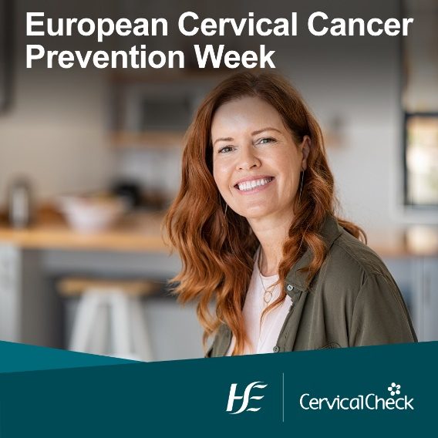
Support the campaign
We welcome your support in sharing the messages by posting, sharing or retweeting the key messages. Below is a sample post or you can share the posts directly from our accounts on:
Facebook: www.facebook.com/cervicalcheck
Twitter: @HSElive
Hashtag: #CervicalCheck
The video with Dr Nóirín Russell is available on the HSE YouTube channel and Dr Russell was also interviewed for the Journal.ie
You can access the translated videos here.
You can also share the Journal.ie and Independent.ie articles.
If you have any queries or ideas, please contact communications@screeningservice.ie or Aoibheann Ní Shúilleabháin, HSE Communications, AoibheannNiShuilleabhain@hse.ie
Regular cervical screening is one of the best ways to reduce your risk of cervical cancer. Learn why we now screen for HPV. www2.hse.ie/screening-and-vaccinations/cervical-screening/what-cervical-screening-is.html#compare

